Slide 1





DESIGNING INCLUSIVE PUBLIC SPACES THROUGH PARTICIPATORY AI
WeDesign+
Psi
03 July 2025
Notes:
Good morning. I am Rashid Mushkani.
I will present WeDesign, which is the product, and Psi, Public Space AI, which is the startup.
At Psi, we help designing inclusive public spaces through participatory AI

Slide 2
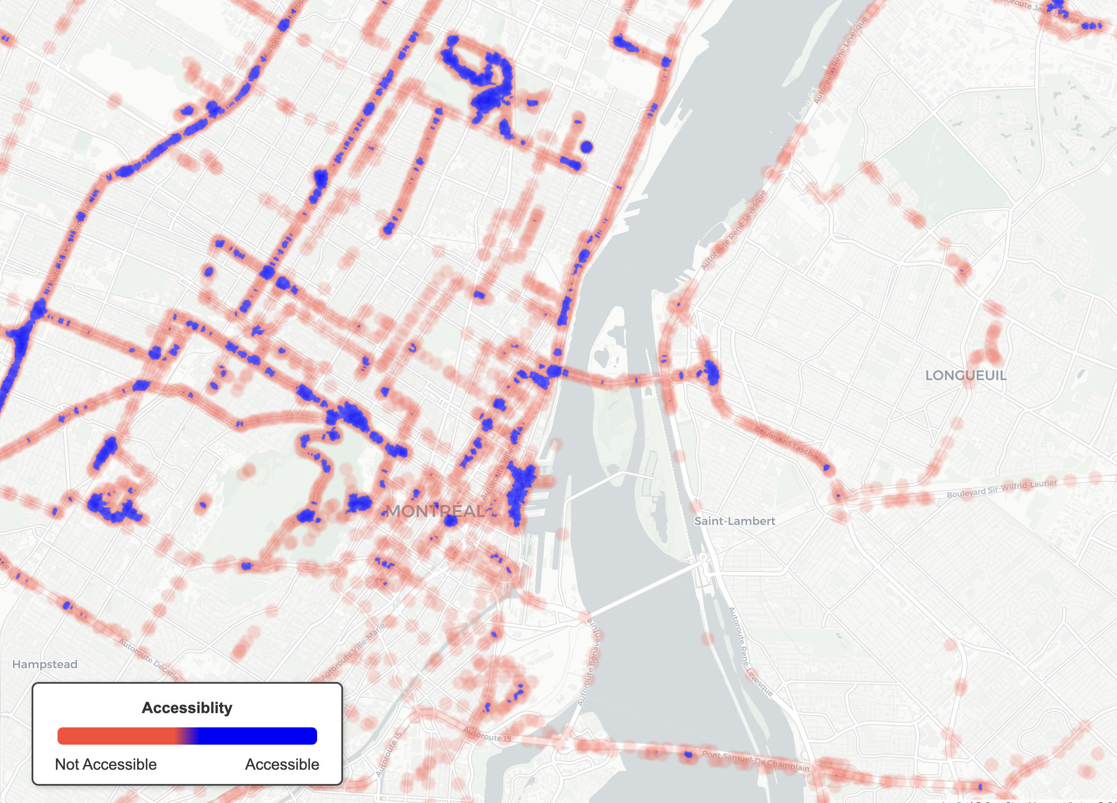
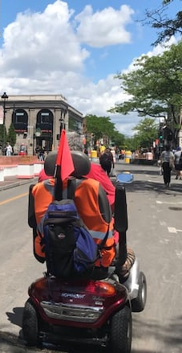
La Fontaine Park
St Lawrence
River
“We
are not welcome”
Linda Gauthier, Plateau
Mount Royal
Notes:
Do you remember March 15, 2020? Lockdown began. We were not able to go outside. For most of us, that lockdown ended, but for six million Canadians with some form of disability, city life is still a lockdown.
They include people like Linda Gauthier, a wheelchair user. In an interview, she said, “We are not welcome.”
Motivated by this, three years ago I began my doctoral research by measuring the quality of public spaces. Here is an example of the result, which shows an accessibility map of the city of Montréal. For a wheelchair user, Blue means accessible. Orange means not accessible and they are everywhere.

Slide 3
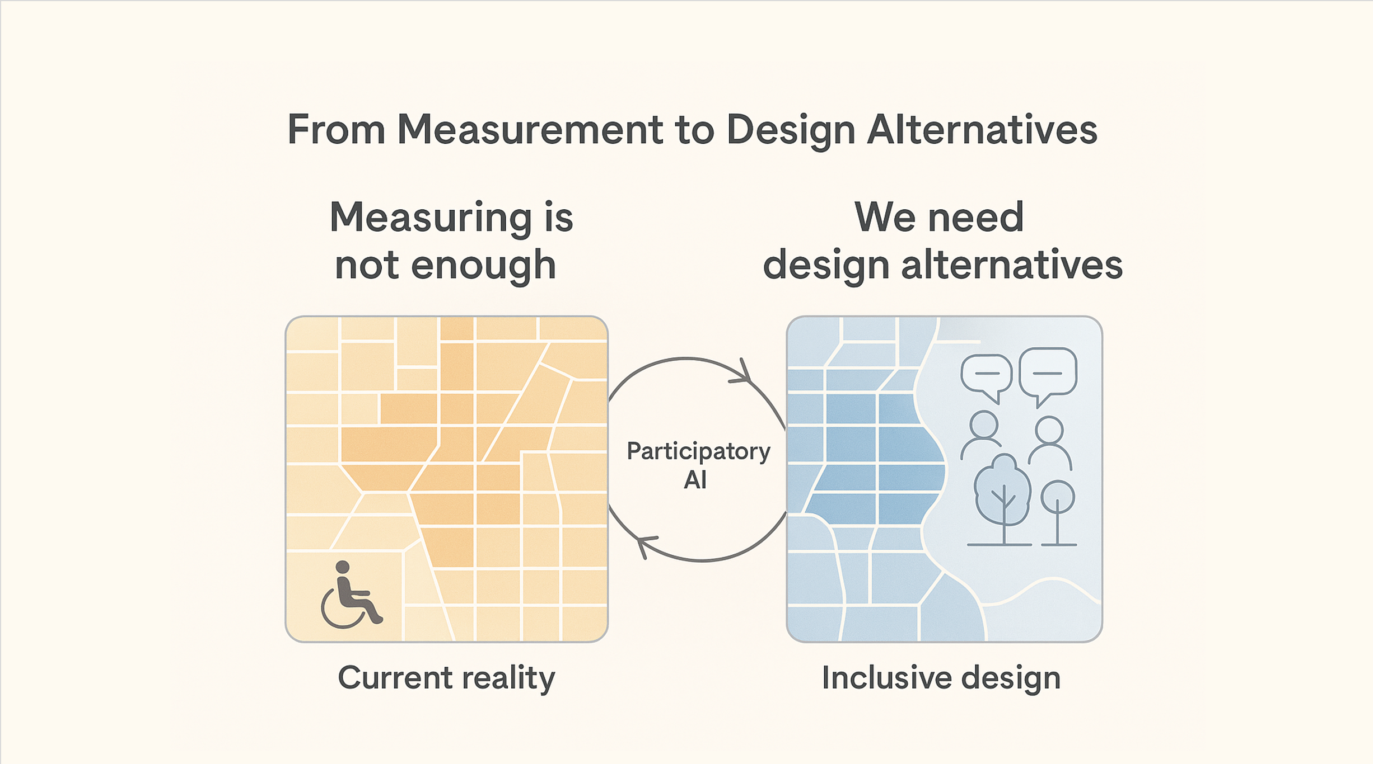
Notes:
Looking at this map, I realized that measuring is not enough, we need design alternatives. The core problem is the lack of inclusive design, caused by poor community engagement and limited access to visualization tools.

Slide 4
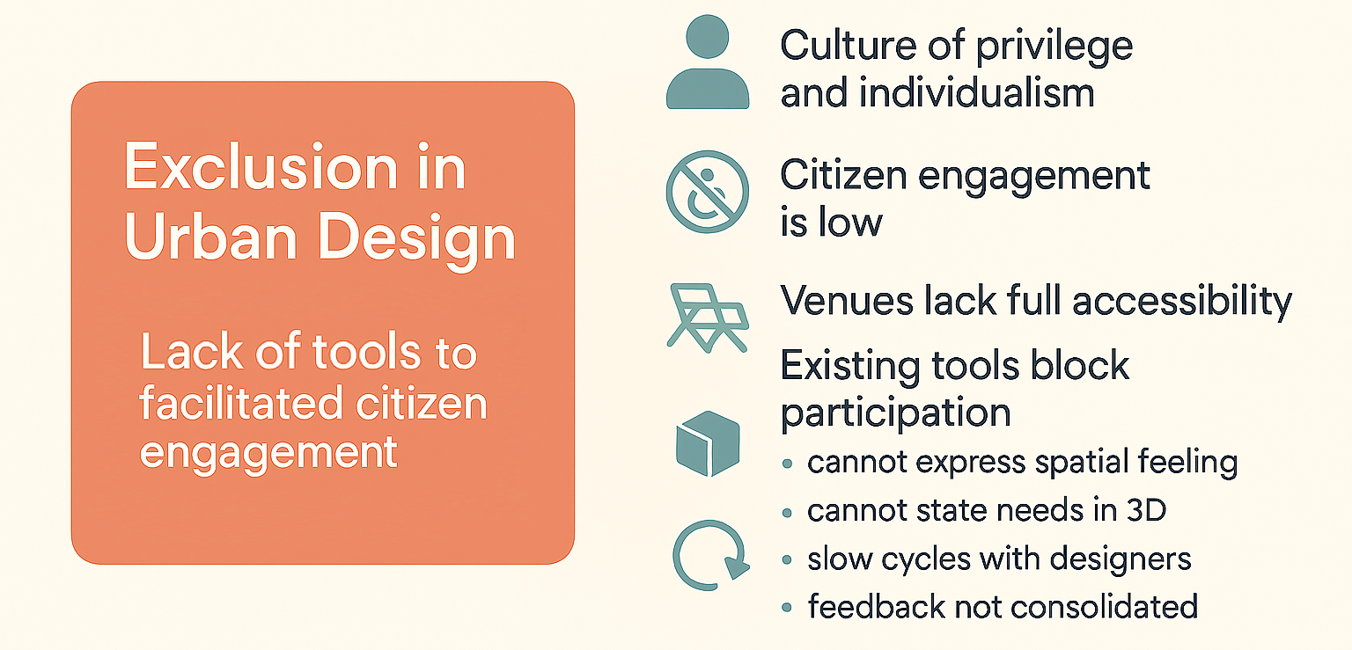
Problem
Notes:
Public consultations are supposed to give voice to citizens,
but often don’t, due to a culture of privilege and individualism, inaccessible venues, scheduling issues, timing, and poor communication.
There is also a lack of tools to facilitate effective design consultations.
Creating visuals, itself, is a skill set typically limited to architects and designers.
Those who face the largest barriers are often excluded.

Slide 5
There are systemic barriers preventing public spaces from reflecting the genuine and collective needs of those inhabiting these environments
Notes:
In brief, systemic barriers prevent public spaces from reflecting the genuine, collective needs of those who use them.

Slide 6






Altergo
La Maisonnée
Cummings
Community Center for Seniors
Marguerite-Bourgeoys Hub
RÉZO
Afrique au Féminin
L’Agence On est là!
Montreal Women’s Groups Table
LGBTQ+ Community Center of Montreal
Women’s Center of Plateau Mont-Royal
Congolese Community Center of Montreal
…
30+ Community Organizations
Notes:
So I started collaborating with organizations, planning firms, the UNESCO Coalition of Inclusive Municipalities, AI4Humanity at Mila, and the Centre de Développement Communautaire (CDC-Centre Sud),
along with over 30 community organizations representing diverse groups.

Slide 7
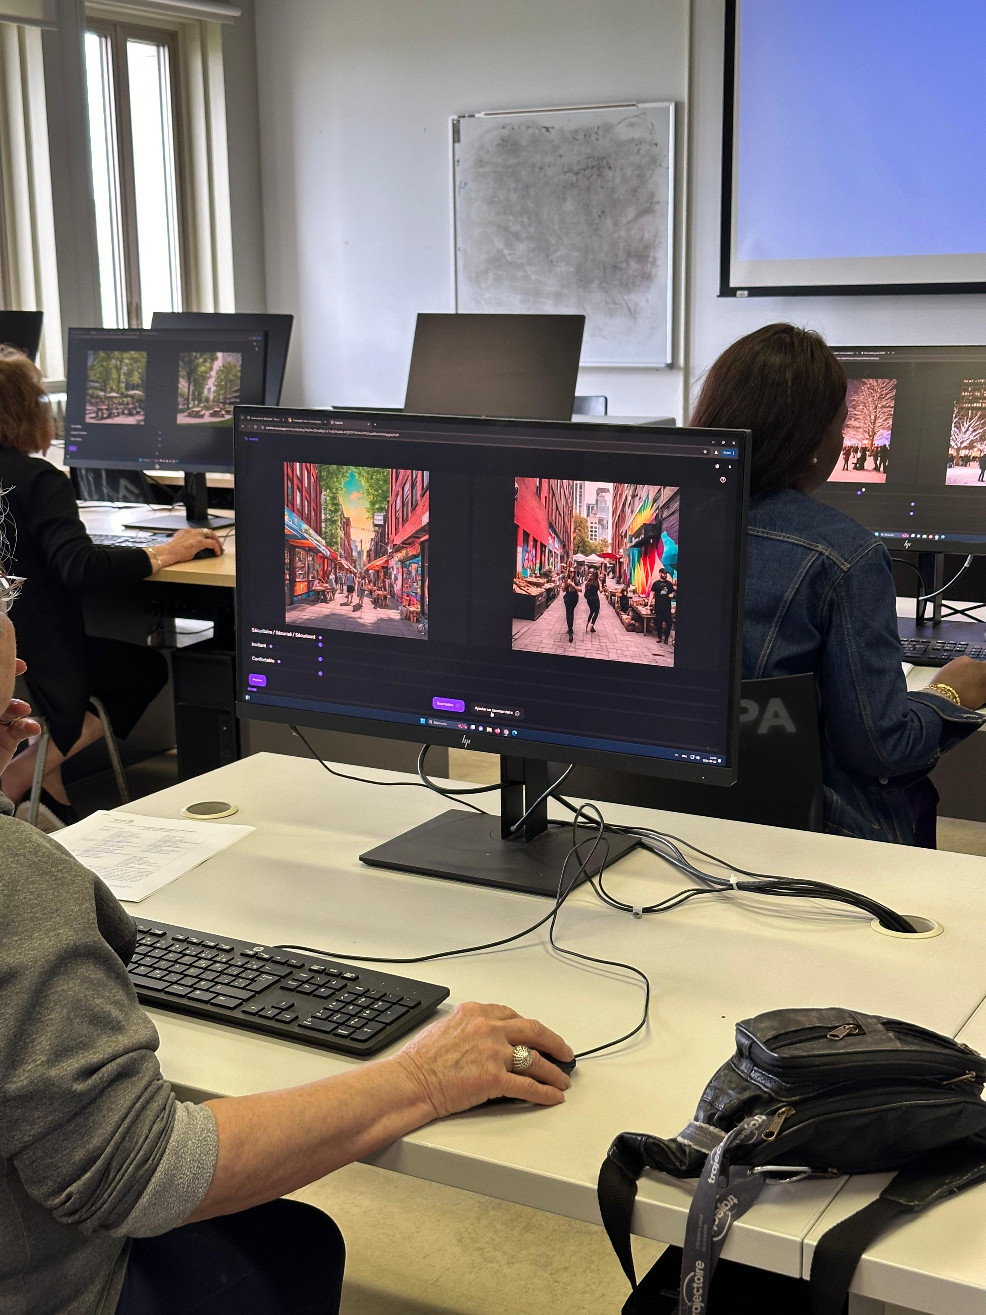
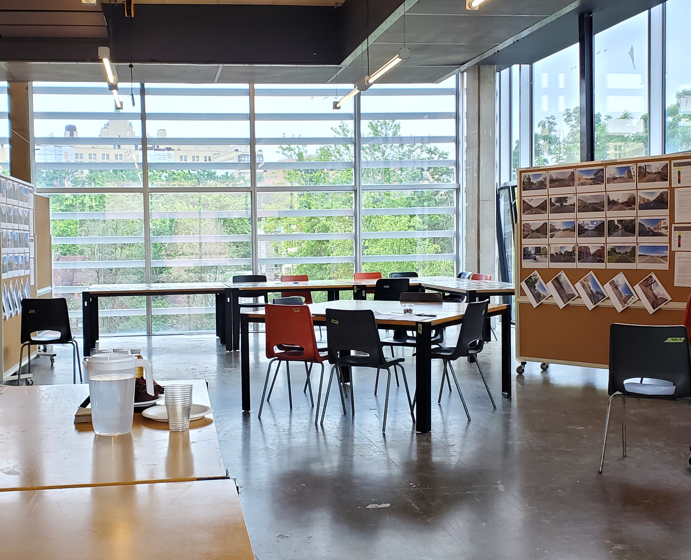
Participatory Approach
Notes:
Through a series of participatory workshops, 11 in total, and with over 100,000 community-labeled images, we created WeDesign,

Slide 8

Notes:
with features facilitating both synchronous and asynchronous participation.
WeDesign visualizes spoken or written ideas, trigger discussion, and spark creativity.
WeDesign effectively reduces the consultation burden, time, and material costs.
Residents see their contributions and resulting visuals on the screen, not hidden in meeting notes.

Slide 9
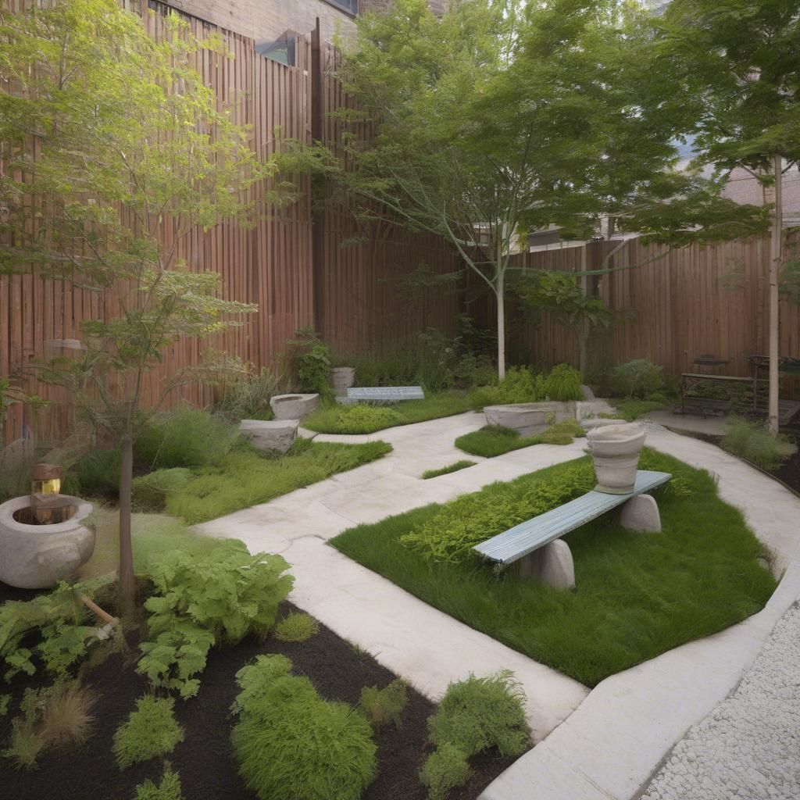
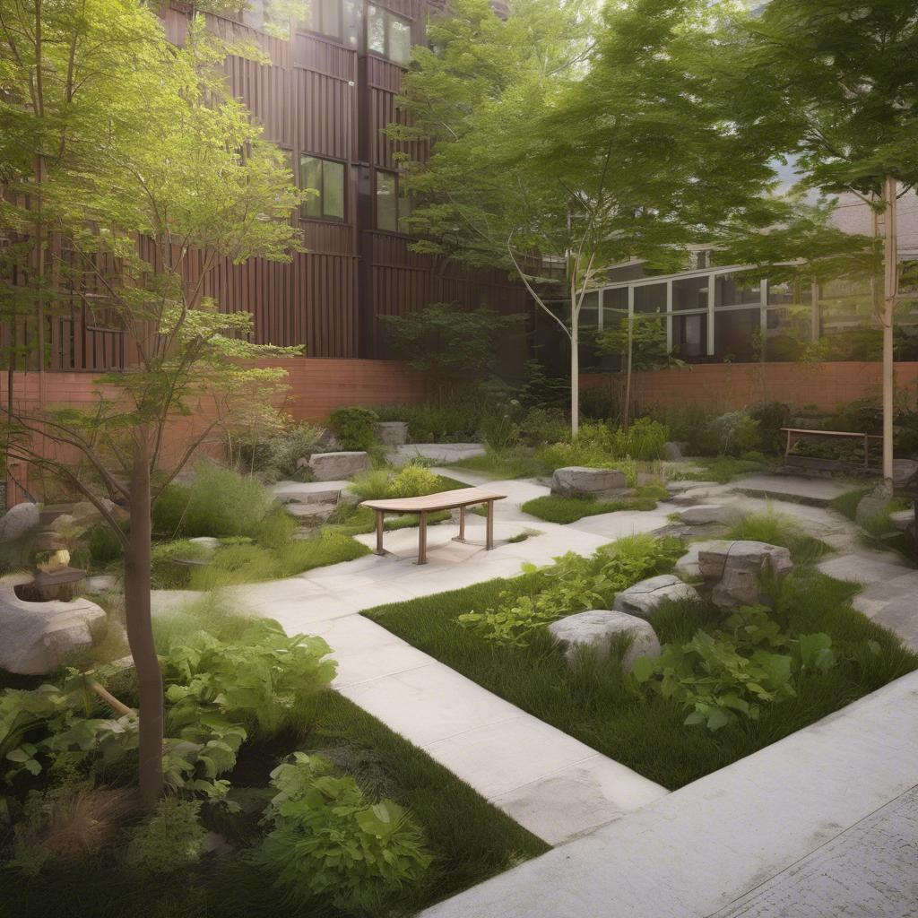
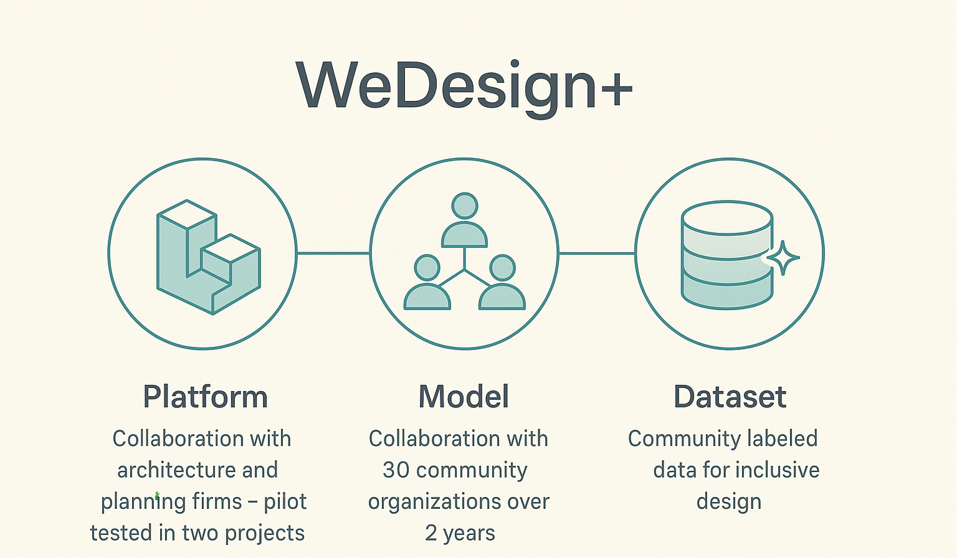
Before
"A quiet, inclusive meditation garden in a busy urban area."
After: WeDesign+
Notes:
WeDesign consists of a platform refined through workshops, and a model that creates visuals, built on a dataset we co-created with over 30 community organizations.
Here is an example of the before and after of an image generator, Stable Diffusion XL, finetuned using our dataset.
The image on the right shows better spatial transitions for wheelchair users, better enclosure, and seating.

Slide 10

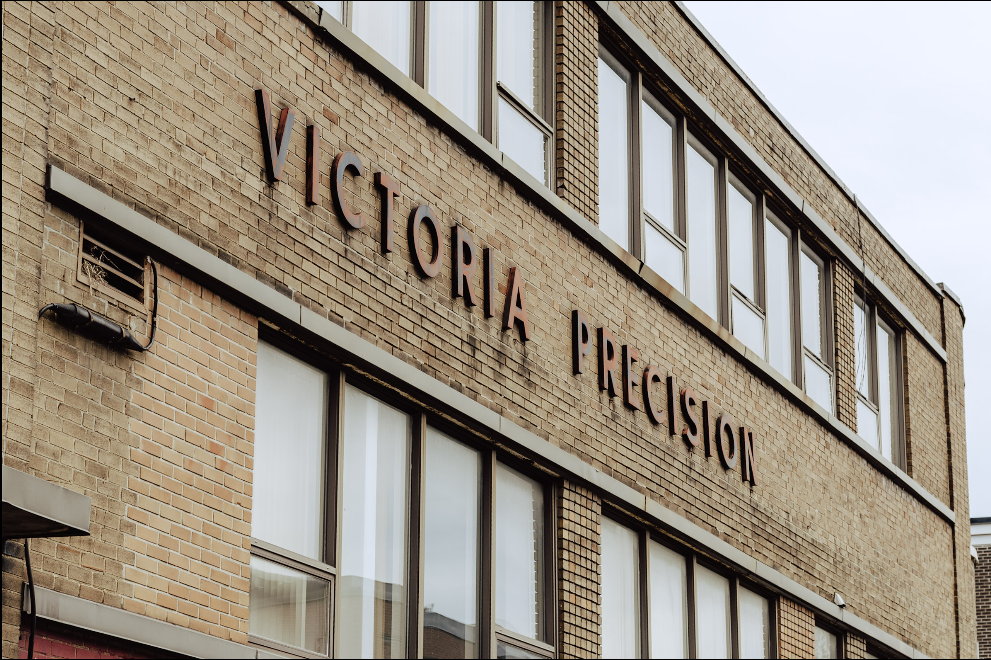
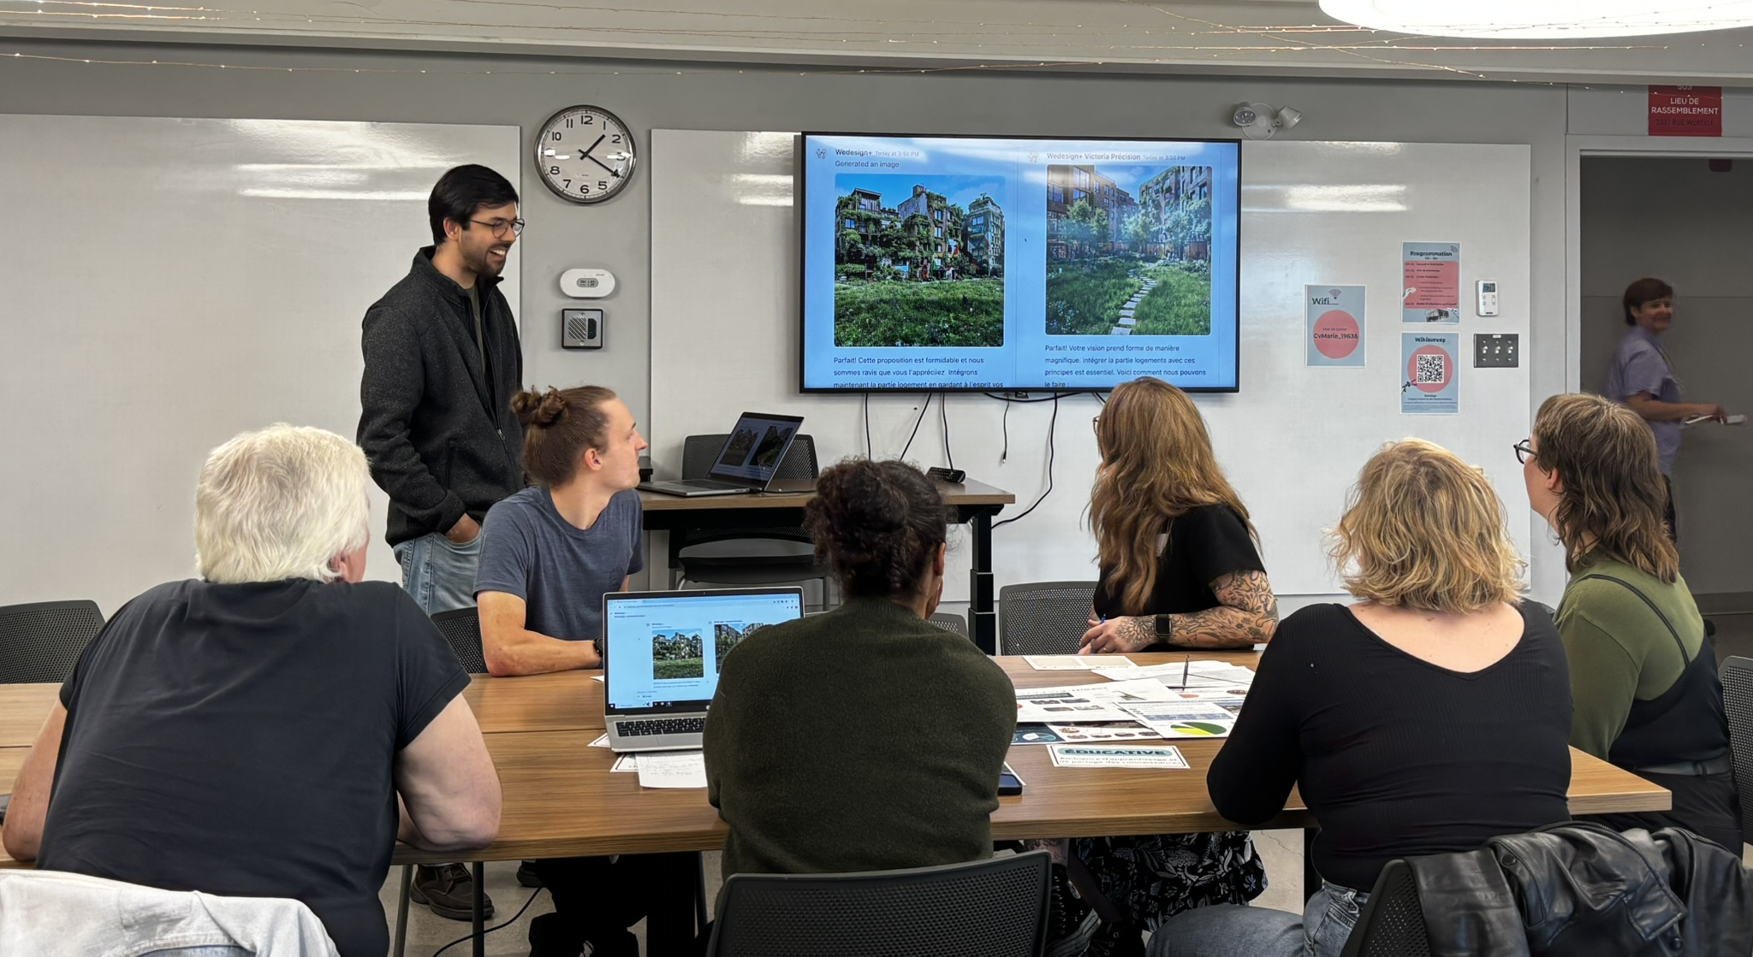
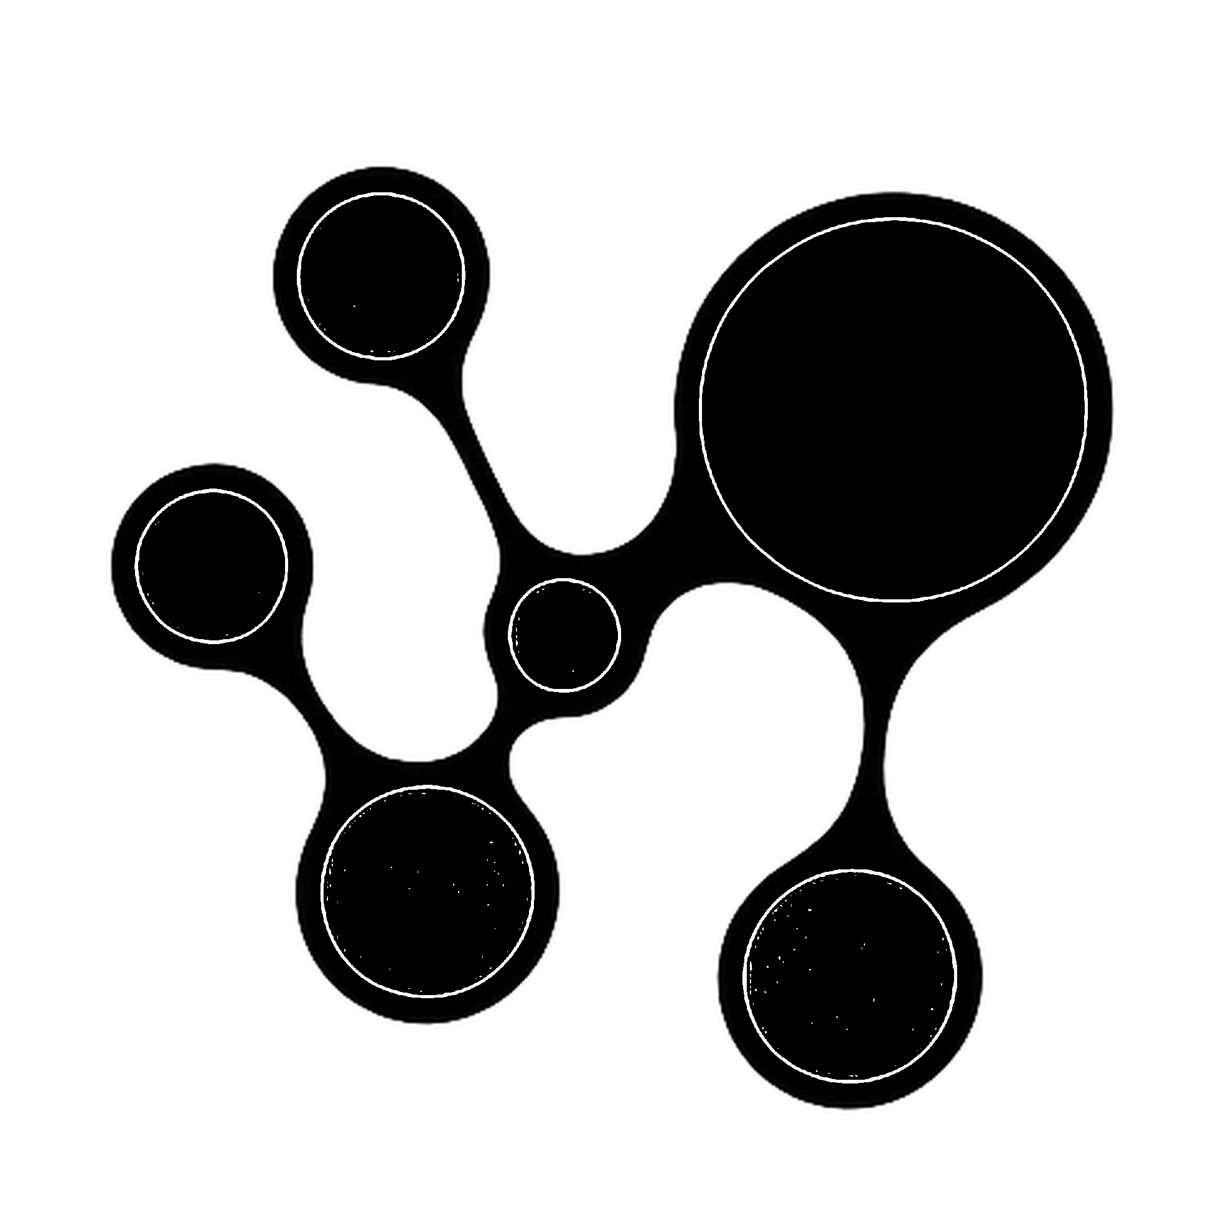
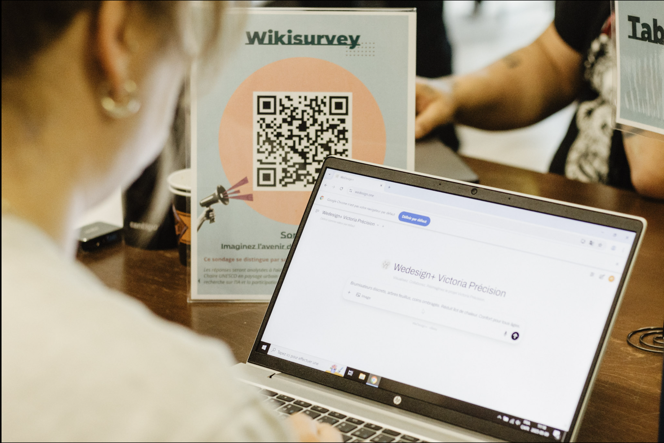
Imaginez le futur du site Victoria Précision… avec l’IA!
Notes:
We piloted this in the Victoria Precision Project,
an old industrial site in Ville-Marie, in collaboration with CDC-Centre Sud.
Participants reported better engagement, creativity, and satisfactory outcomes.
As a participant said: "This is the first time I felt really engaged"

Slide 11
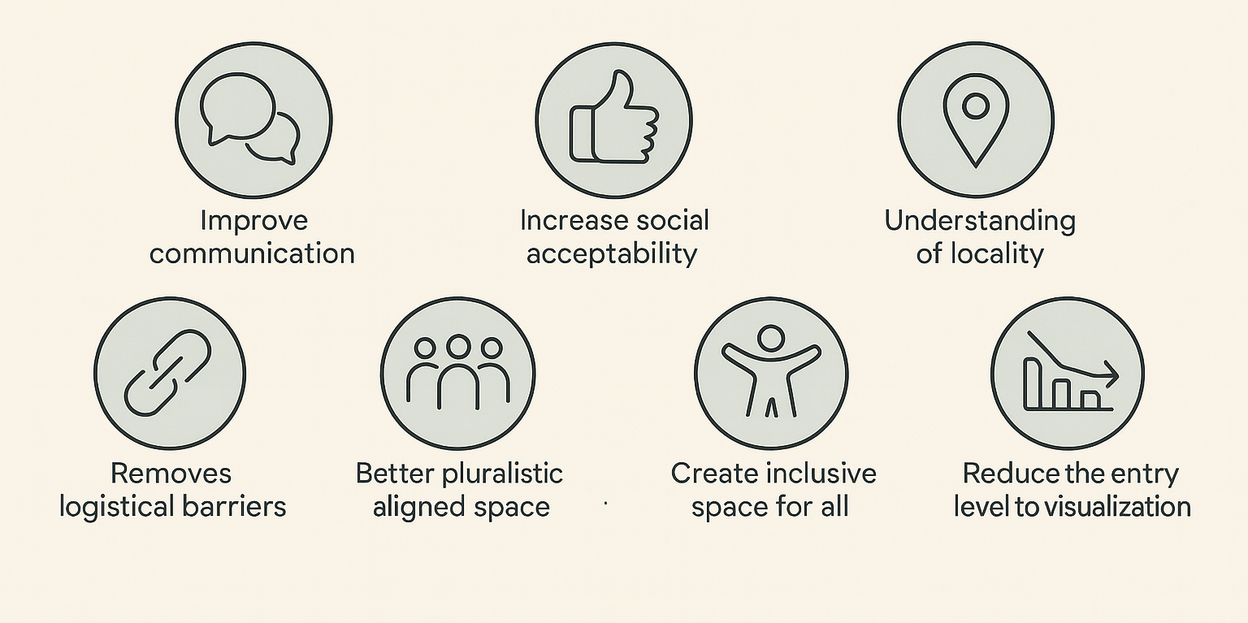
Value We Deliver
Further Research
Notes:
Overall, we improve communication in collaborative design, increase social acceptance of projects through genuine participation,
and our model better understands local spaces and pluralistic preferences. We lower the barrier to visualization by democratizing it.
-
-
Further research and products are part of Psi’s long-term mission: to create inclusive and pluralistic spaces, which I will focus on during and beyond my postdoc.
Together, these benefits shorten project timelines, cut revision cycles, and strengthen public support, which is why partners invest in WeDesign.

Slide 12
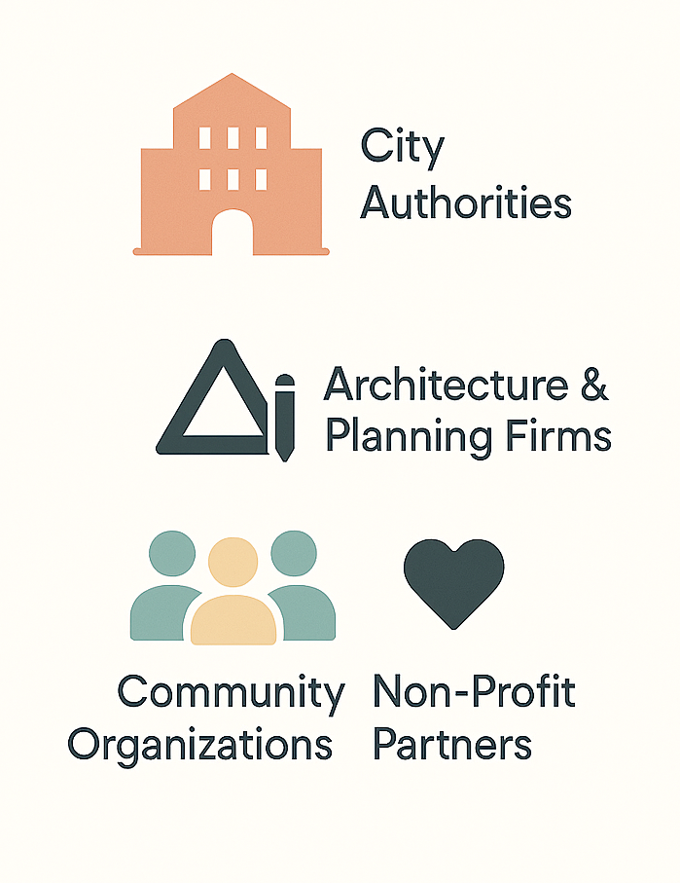
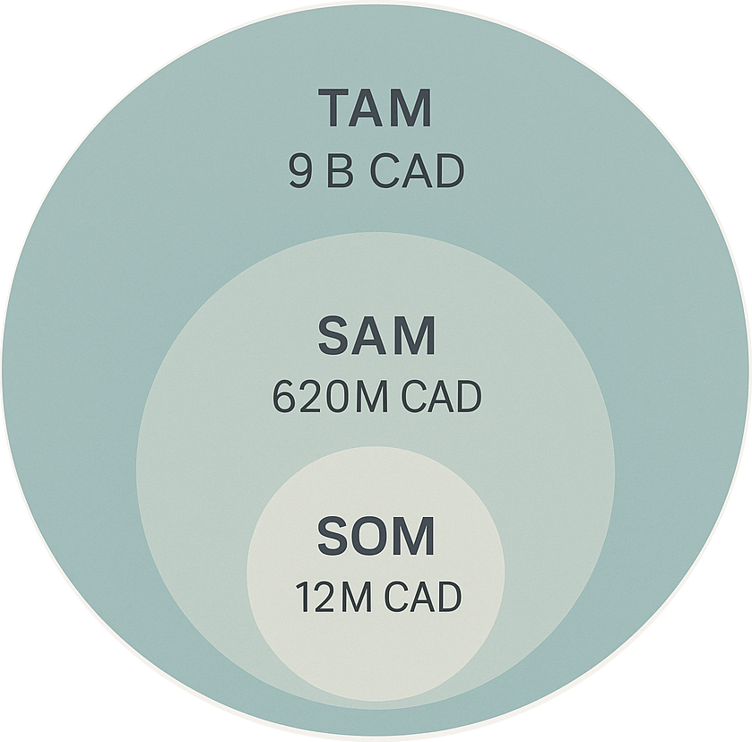
Market
https://dataintelo.com/report/citizen-engagement-software-market
https://datahorizzonresearch.com/citizen-engagement-software-market-46384
Shin B. et al. “A systematic analysis of digital tools for citizen participation,” 41 (3): 101954.
Zhao B. et al. “Digital transparency and citizen participation: Evidence from the online crowdsourcing platform of the City of Sacramento,” 40 (4): 101868.
Notes:
TAM (Total Addressable Market)
SAM (Serviceable Addressable Market)
SOM (Serviceable Obtainable Market)
Our users are municipalities, planning and architecture firms.
Since, they seek better engagement strategies and efficient ways to gather and analyze design feedback.
Community organizations and researchers can also use it for projects that involve designing or reimagining spaces, especially in response to challenges such as climate or inclusivity.
Civic engagement and visualization software is a 9 billion market in North America today, projected to reach 20 billion in 8 years. Canada, with over 10,000 cities, represents about 600 million of this.
Canada’s architectural visualization software sector is worth 280 million. For WeDesign, there is a 12 million obtainable market in Canada alone.
Bureau d’audiences publiques sur l’environnement (BAPE), 8.6 Million
Office de consultation publique de Montréal (OCPM) 3.3 Million

Slide 13
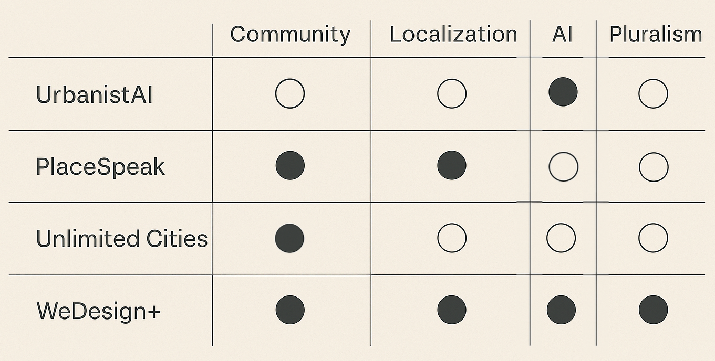
Competitive Landscape
Notes:
Current competitors include UrbanistAI, which generates images using generic data;
PlaceSpeak, which handles consultations but lacks image generation;
and Unlimited Cities, which allows users to annotate photos but doesn’t use AI.
WeDesign is novel because it combines community engagement with generative AI to visualize pluralistic local values.

Slide 14
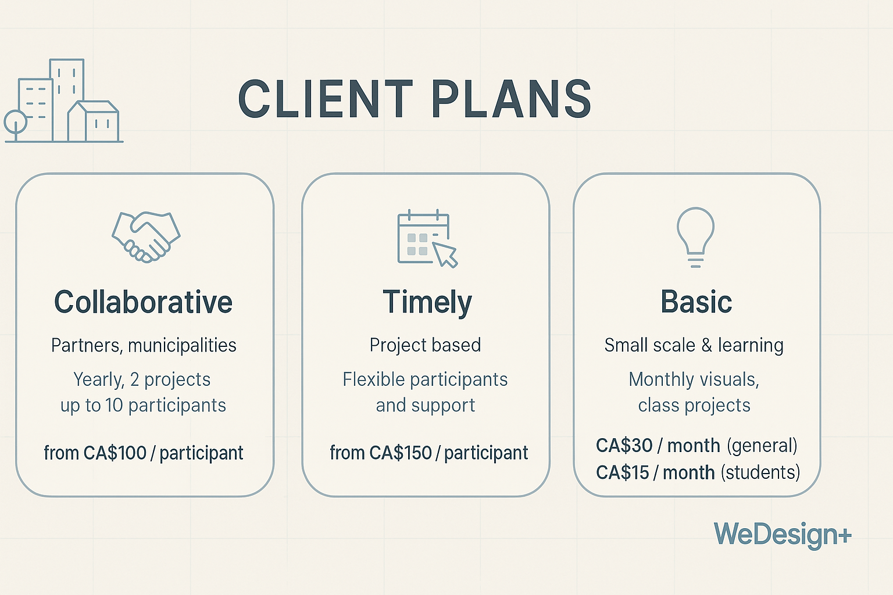
Business Model
Notes:
We operate on a software subscription model with three plans:
Collaborative: a yearly plan with a minimum of two projects, 100 per seat.
Timely: project-based, starting from 150 per seat.
Basic: for architecture students and small community projects.

Slide 15
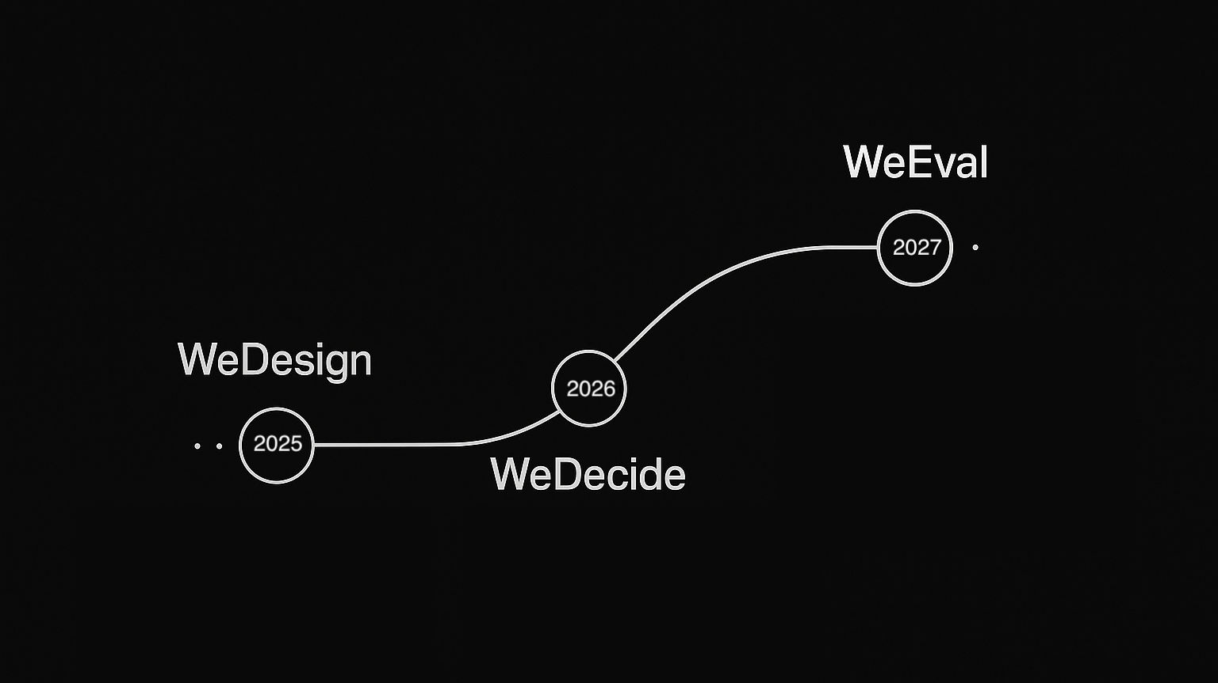
Psi Product Outlook
Notes:
At Psi, we are building an ecosystem of products aligned with our mission of creating inclusive cities.
WeDecide and WeEval are next. WeDecide analyzes mass citizen feedback through transparent aggregation.
WeEval measures the quality of urban spaces.

Slide 16
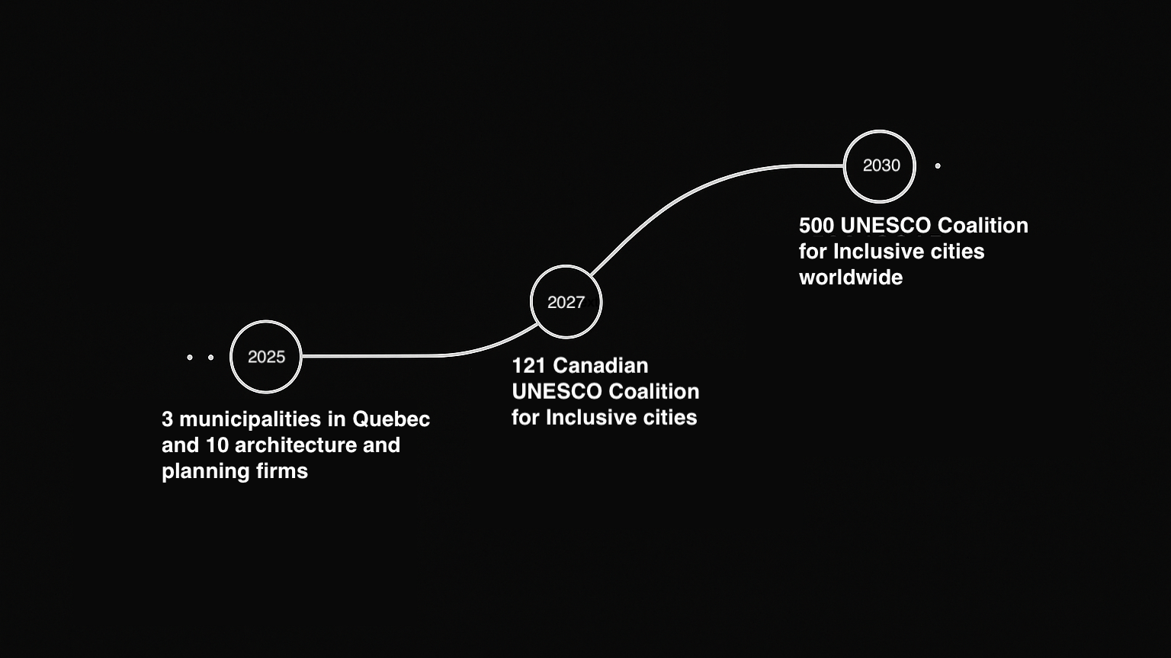
Psi Market Outlook
Notes:
We have secured interest from seven organizations and aim to double that in the coming months.
Over the next two years, we plan to consolidate WeDesign through the Coalition of Inclusive Municipalities, which has 121 Municipal members here in Canada.
The Canadian Commission for UNESCO has been a key collaborator. In five years, we aim to reach all 500 inclusive city coalition members worldwide.

Slide 17
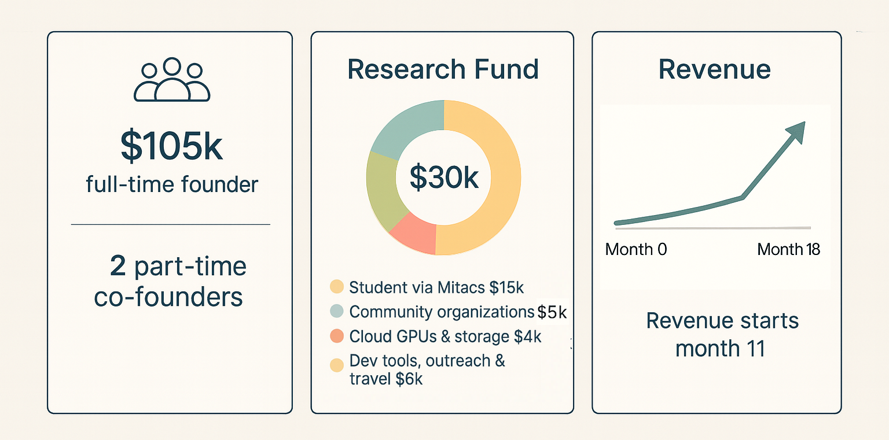
Financial Plan
Notes:
The eighteen-month IVADO funding is key. It enables me to focus full-time on the startup.
Revenue begin in month 11 with pilot cities and partner firms.
Of the $30,000 grant, 15 thousand will fund a Mitacs intern, 5 thousand will go to community labeling, 4 thousand to cloud computing, and 6 thousand to development and outreach.

Slide 18
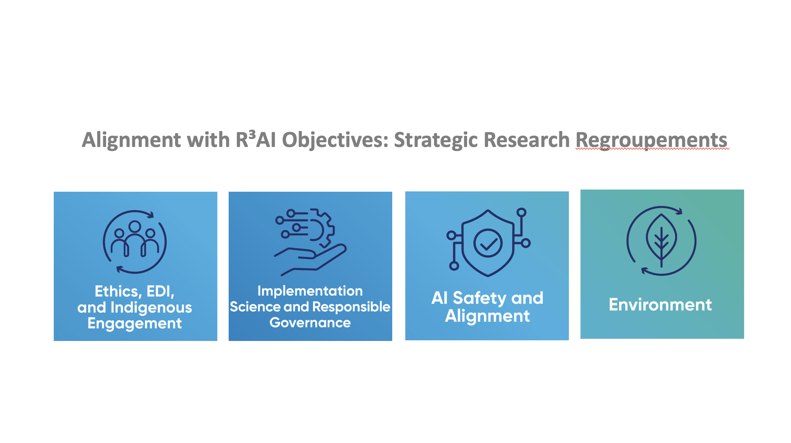
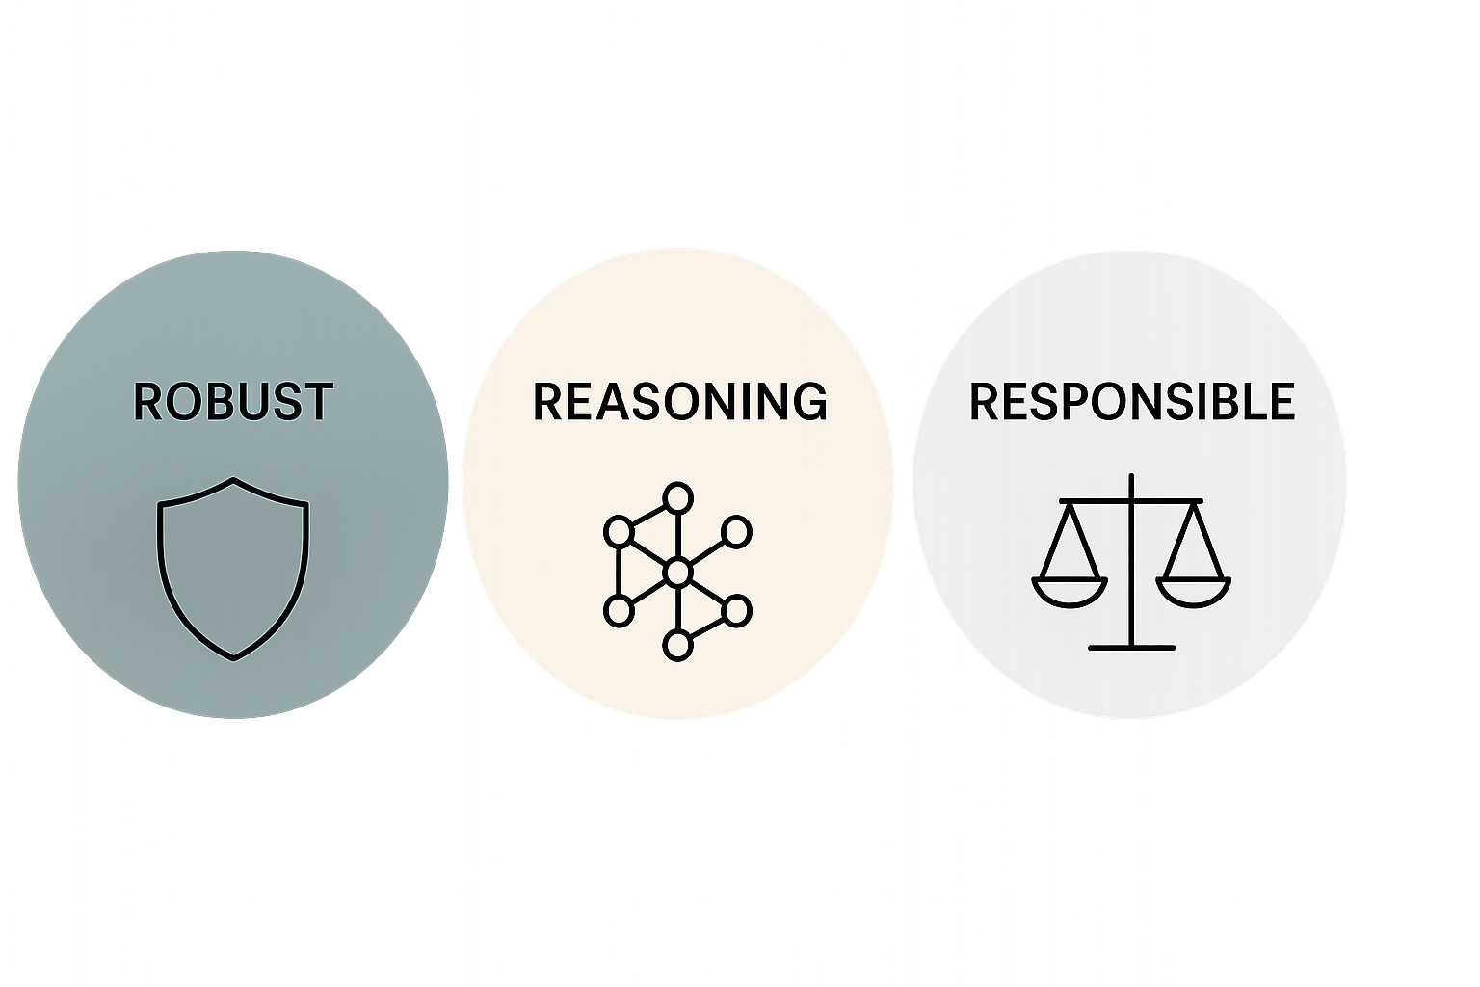
Alignment with R³AI Objectives
Notes:
WeDesign aligns with the 3R objectives:
Robust: stress-tested and refined through community post fine-tunning
Reasoning (in its weakest sense): every image links to its prompt and label
Responsible: data generation starts with marginalized voices through participatory approach.
We also address four regroupments under the 3R Objective: EDI, Governance, Alignment, and Environment.

Slide 19
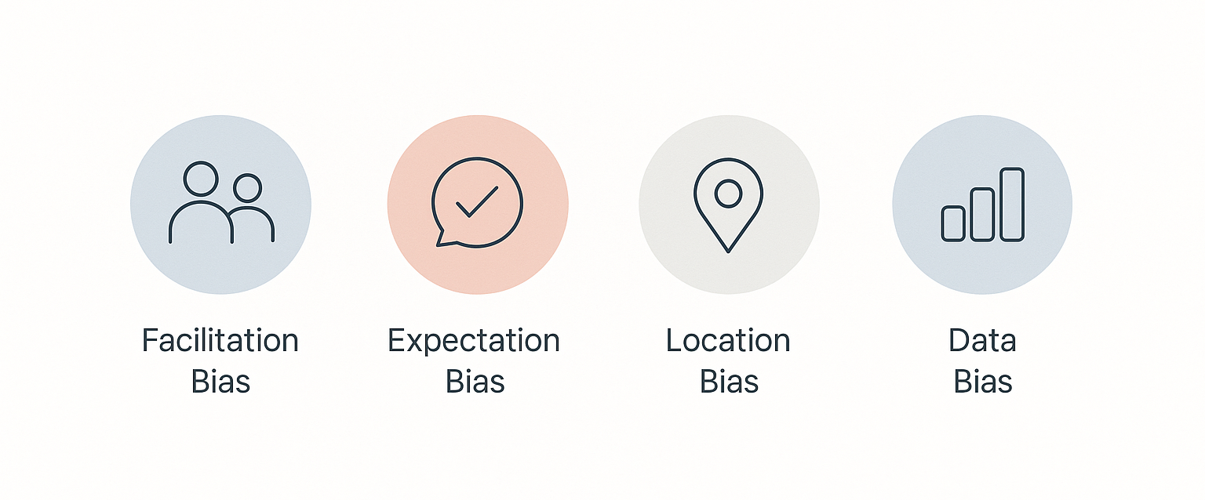
Ethical Safeguards
Notes:
There are ethical concerns:
Facilitation bias (the tool is not a replacement for facilitators),
Expectation bias (realistic images may raise unrealistic expectations),
Location bias (limitations in understanding place names and context),
Data bias (foundational training data on what we call "hot garbage").
We address these through disclaimers, participatory auditing, open logs, and quarterly audits with partners.

Slide 20
Develop Advanced Pluralistic Alignment Techniques.
Enhance models to handle pluralistic values effectively.
Use equal ratings.
Enhance models to better understand local places.
Notes:
During my postdoc, I aim to develop advanced pluralistic alignment techniques.
For example, as you can see here, disabled participants often disagreed with the majority, for valid reasons.
How we ensure their transparent representation?
I also aim to improve model understanding of local places by crafting a new dataset.

Slide 21
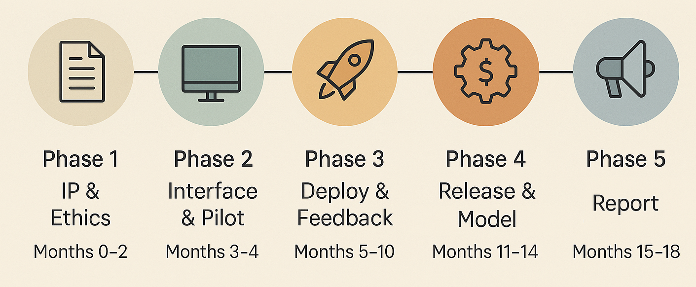
Postdoctoral Timeline
Notes:
My postdoc begins with IP registration and acquiring ethics certificate for new data labeling. Which leads to testing new methods of pluralistic alignment.
I will then develop the interface further and deploy a beta version online.
By month 10, we plan a multilingual city rollout; by month 12, full release across Québec.

Slide 22
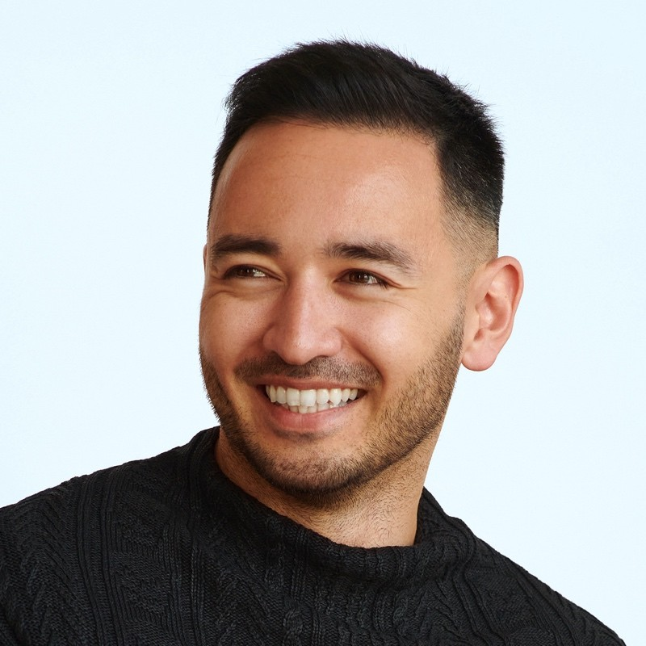
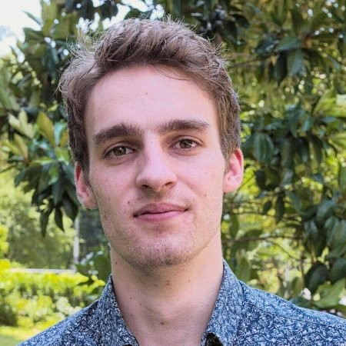
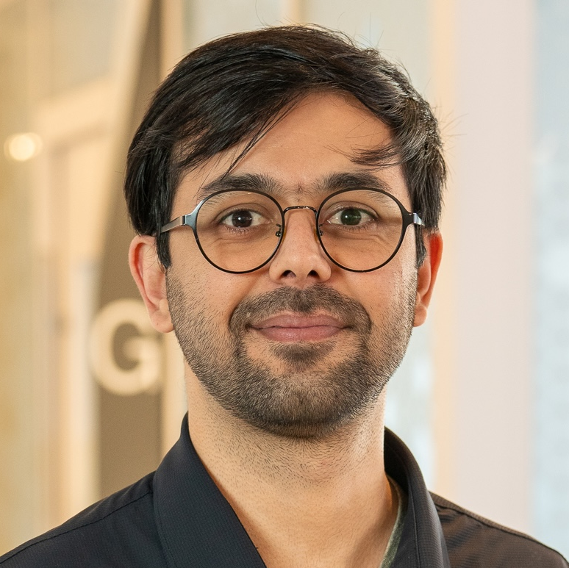
Team
Shin Koseki
CFO
Hugo Berard
CTO
Rashid Mushkani
CEO
Notes:
Our team includes three co-founders:
I lead software, AI, outreach, and product. I have eight years in urban design, five years in AI research, and have led multidisciplinary teams, here, at Mila and UdeM, and abroad. My expertise includes inclusive urbanism and participatory AI
Hugo Bérard, PhD in AI, CTO, currently a postdoc in AI and urbanism at UdeM
Shin Koseki, CFO, assistant professor at UdeM, and UNESCO Chair, is an expert in the politics of urban planning and finance.
Together, we are a multidisciplinary team with cross-continental lived experiences and backgrounds.

Slide 23
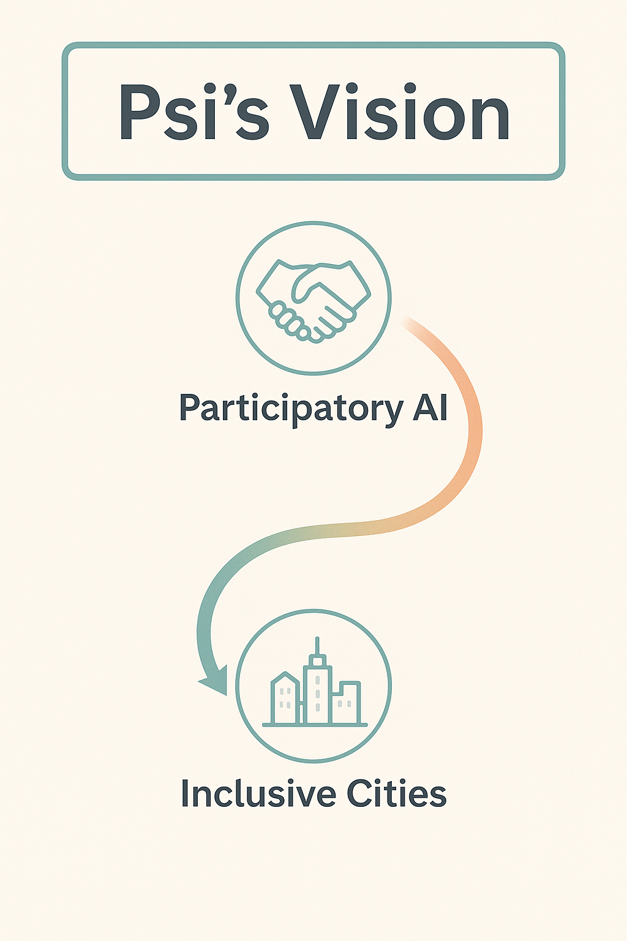
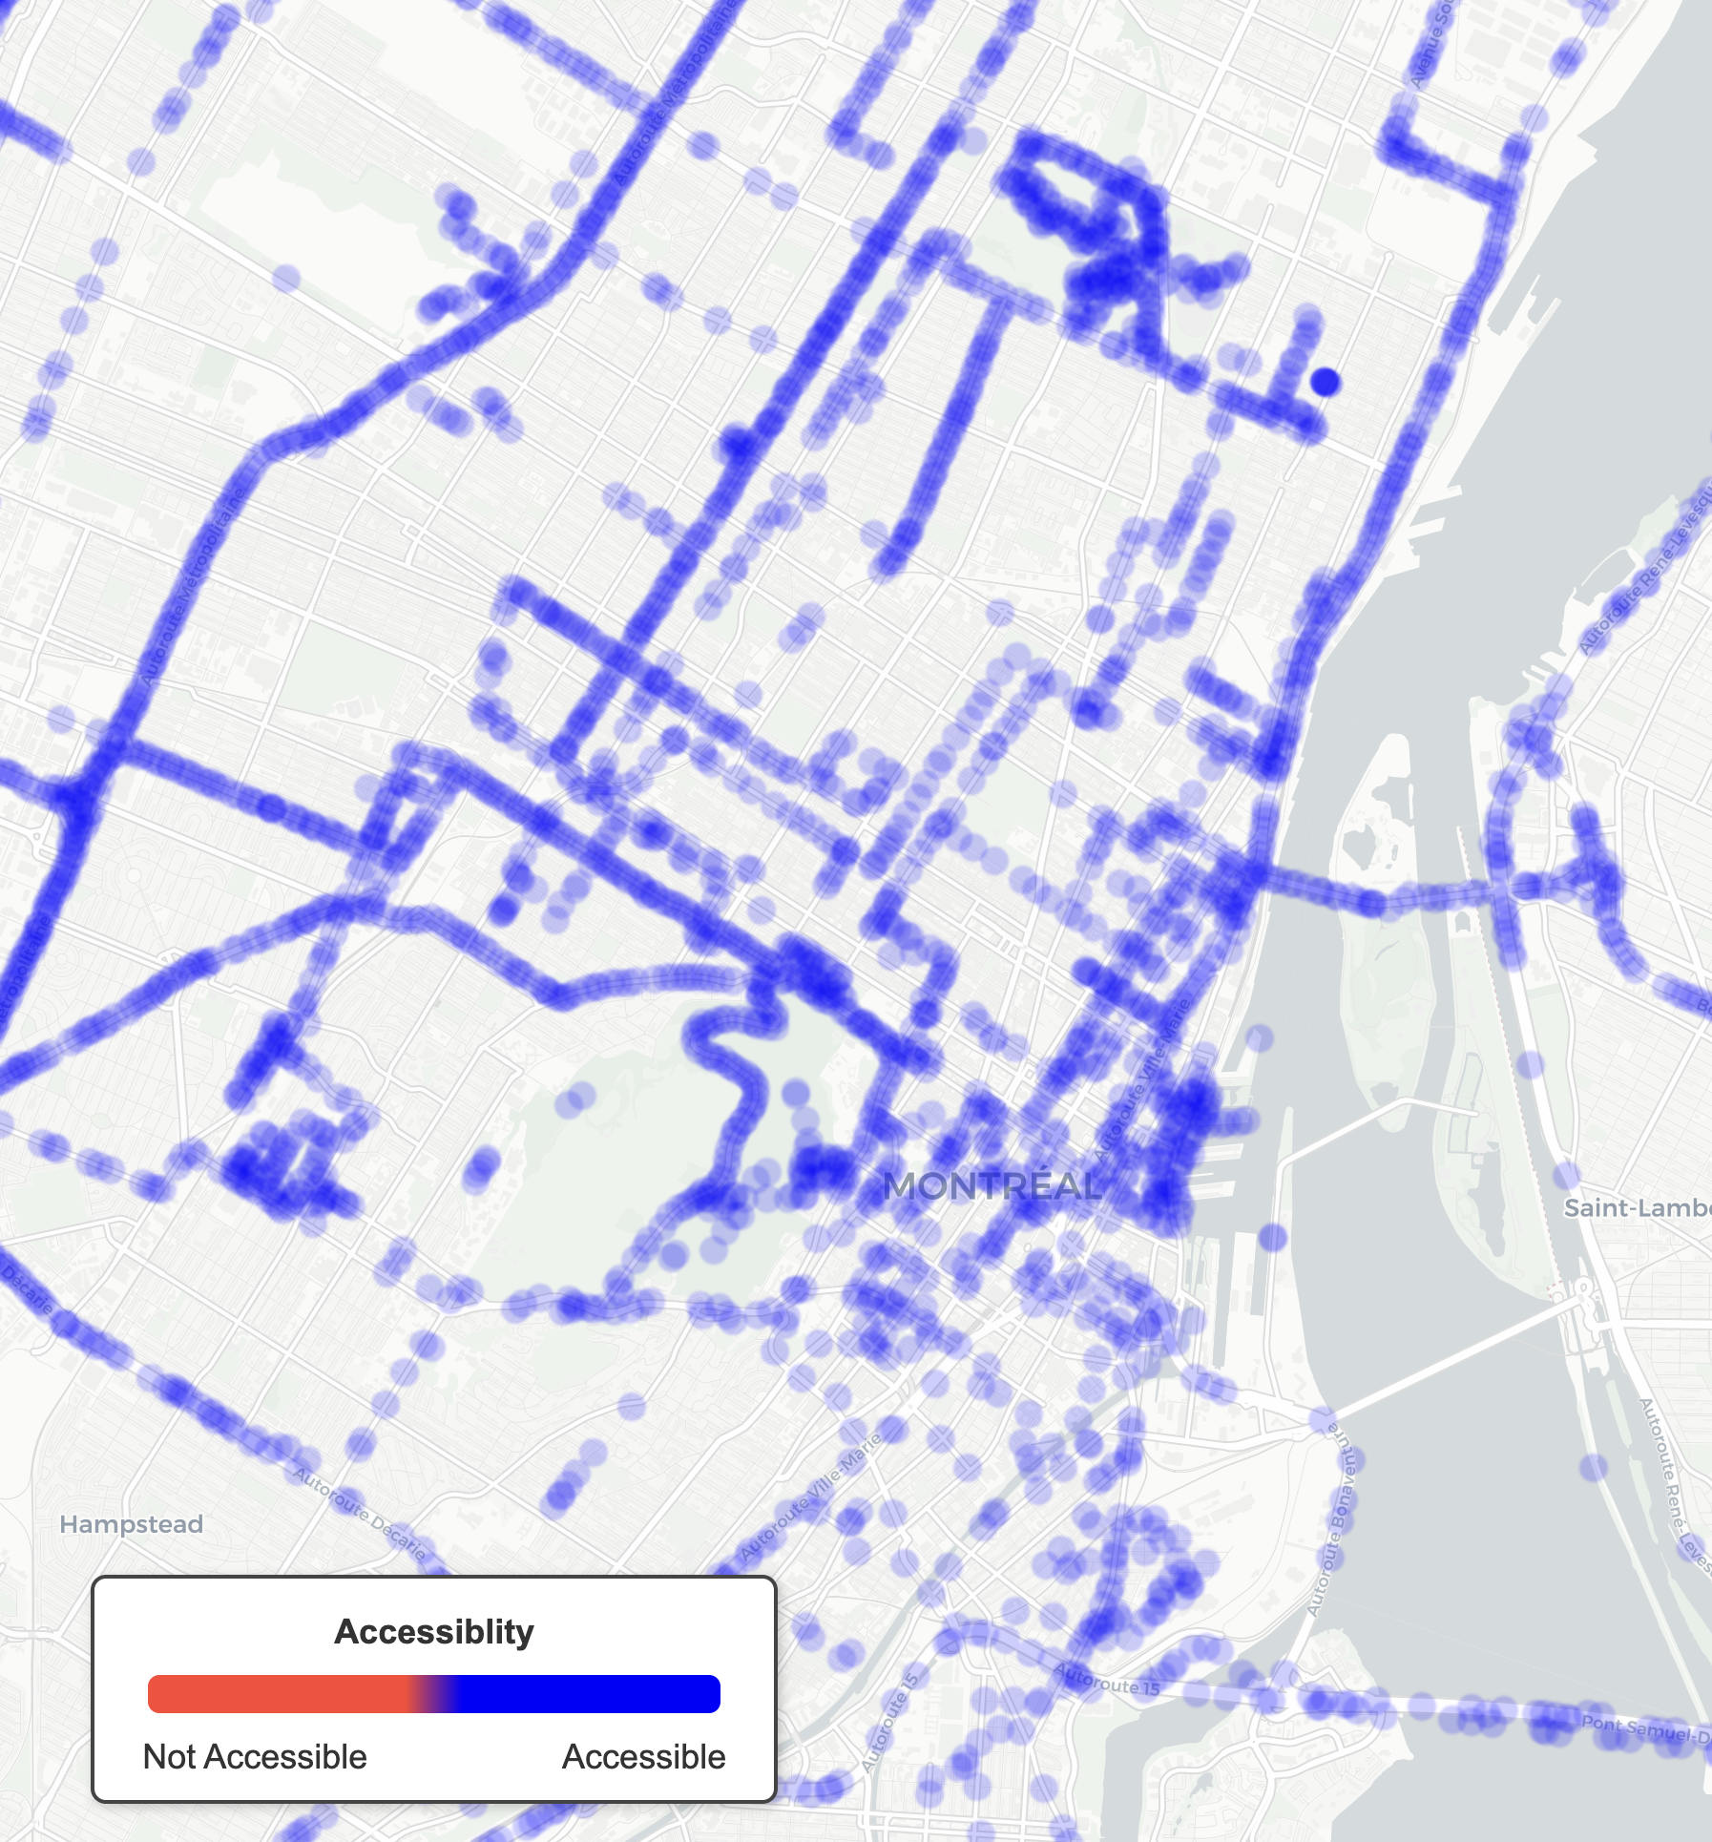
Notes:
I’ll end where I began: turning these oranges into blue.
Psi builds participatory AI to help create inclusive cities
--
where every point turns blue, for everyone. So nobody feels in a lockdown anymore.
Help us make Montréal blue. With IVADO’s support, we can move from successful pilots to deployment across Québec and beyond.
Thank you.

Slide 24
Thank you!

